Slide 1
HTML Document Structure
Essential elements for each HTML document:
<!DOCTYPE>, <html>, <head>, <body>
The <html> element
All the content of the Web page is inside the <html> tag
<!DOCTYPE html>
<html>
…
</html>

Slide 2
Head Element
The <head> contains markup not visible to the user
But helps the browser to render correctly the HTML document
What is in the <head>?
Metadata definitions
Styles declarations
Scripts declarations
Specify the character encoding
<meta charset="UTF-8">
<link rel="stylesheet" type="text/css" href="site.css">
<script src="main.js"></script>

Slide 3
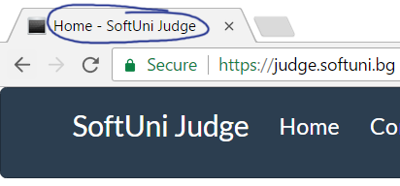
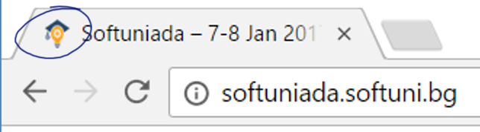
Head Element: Title + Favicon
HTML title
The <title> tag – HTML document title
favicon – a site icon
Favicon generator: http://www.favicon-generator.org
<head>
<title>Home – …</title>
</head>
Favicon
<link href="/favicon.ico" rel="shortcut icon" type="image/x-icon"/>

Slide 4
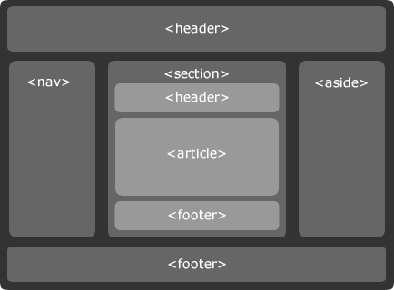
Semantic Structural Tags

Slide 5
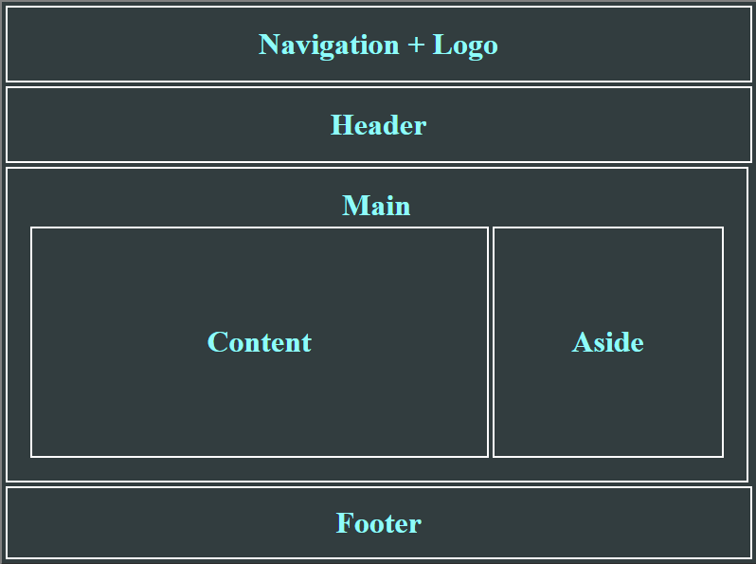
The Structure of a Web Page
A typical layout structure of a Web page

Slide 6
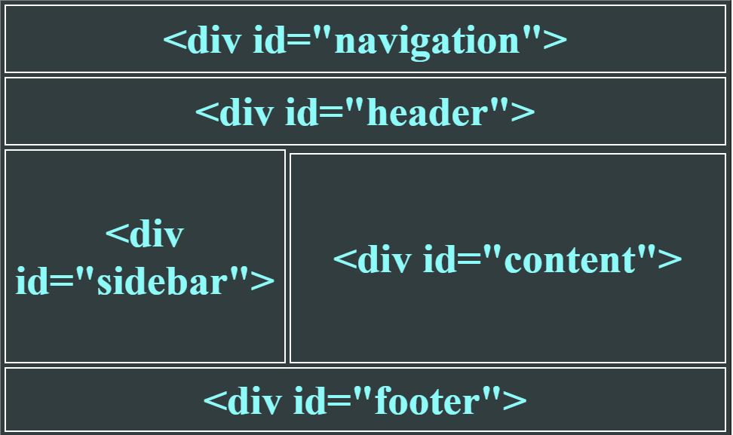
The "HTML 4 and Old" Way
Using <div>s with IDs (the IDs are needed for styling)
<html>
<head> … </head>
<body>
<div id="navigation">…</div>
<div id="header">…</div>
<div id="sidebar">…</div>
<div id="content">…</div>
<div id="footer">…</div>
</body>
</html>

Slide 7
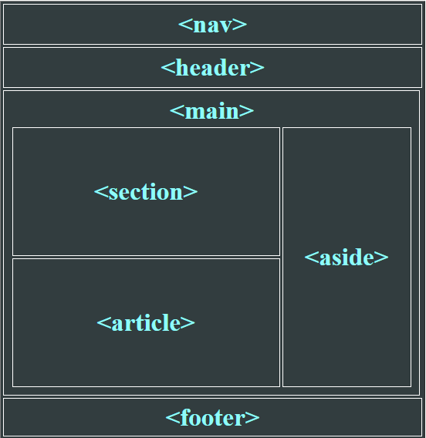
The HTML 5 Way
HTML 5 uses semantic tags for the document structure
<body>
<nav>…</nav>
<header>…</header>
<main>
<aside>…</aside>
<section>…</section>
<article>…</article>
</main>
<footer>…</footer>
</body>

Slide 8
HTML5 Semantic Tags
<nav>
<header>
<main>
<section>
<article>
<aside>
<footer>
<figure> + <figcaption>
<details> + <summary>
<time>
<address>
<dialog>
<audio> / <video>

Slide 9
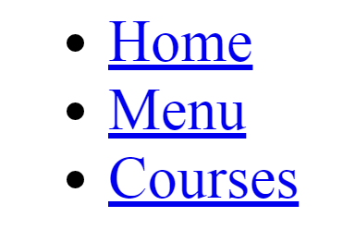
HTML5 Semantic Tags: Nav
<nav> – defines a set of navigation links
<nav id="topmenu">
<ul>
<li><a href="#">Home</a></li>
<li><a href="#">Menu</a></li>
<li><a href="#">Courses</a></li>
</ul>
</nav>

Slide 10
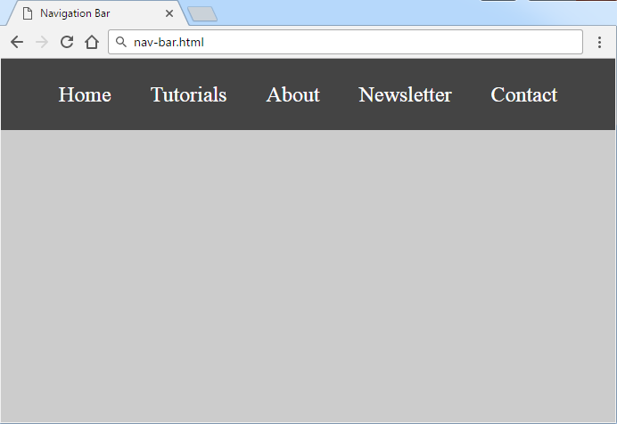
Problem: Navigation Bar
Create a HTML page with navigation bar like the shown below
Hints:
Modify the HTML code from the previous slide
Write some CSS

Slide 11
Solution: Navigation Bar (CSS)
body {
margin: 0;
padding: 0;
background: #ccc;
}
nav#topmenu ul {
list-style: none;
background-color: #444;
text-align: center;
padding: 0;
margin: 0;
}
nav#topmenu li {
font-size: 24px;
line-height: 40px;
height: 40px;
display: inline-block;
padding: 20px;
}
nav#topmenu a {
text-decoration: none;
color: #fff;
}
Check your solution here: https://judge.softuni.bg/Contests/395

Slide 12
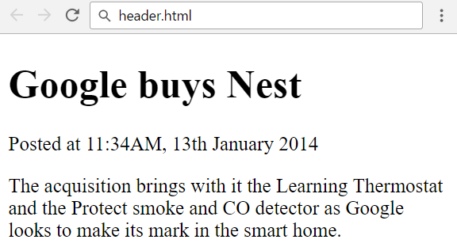
HTML5 Semantic Tags: Header
<header> – holds a document or section header
<header> holds title + posted article date
...
<header>
<h1>Google buys Nest</h1>
<p>Posted at <time datetime="2014-01-13T11:34">11:34AM, 13th January 2014</time></p>
</header>
<p>The acquisition brings …</p>

Slide 13
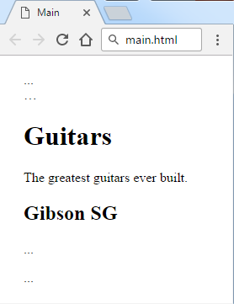
HTML5 Semantic Tags: Main
<body>
<header>…</header>
<nav>…</nav>
<main>
<h1>Guitars</h1>
<p>The greatest guitars …</p>
<article>
<h2>Gibson SG</h2>
<p>…</p>
</article>
</main>
<footer>…</footer>
</body>
Holds the main page content
Use only one <main> tag in the document

Slide 14
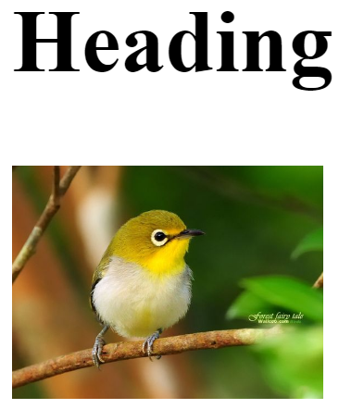
Semantic Tags: Section
<section> – a group of related content
Use <h1> … <h6> to define the topic for the section
<section>
<h2>Heading</h2>
<img src="bird.jpg" />
</section>

Slide 15
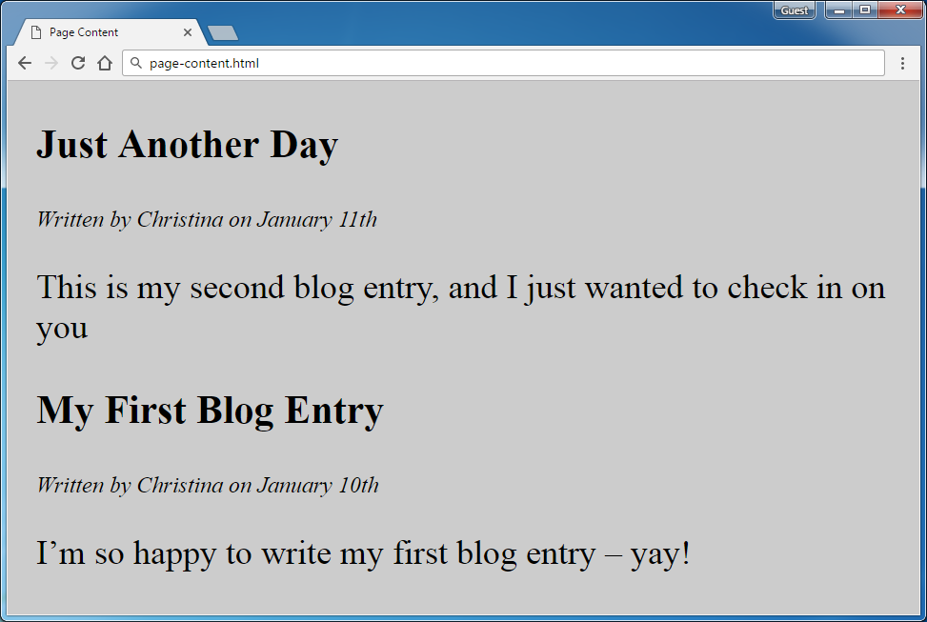
Problem: Page Content
Create a HTML <section>
Holding a few <article> elements with <header>
Like shown on the screenshot
<header>
<article>
<article>

Slide 16
Solution: Page Content (HTML)
<section>
<article>
<header>
<h1>Just another day</h1>
<p>Written by…</p>
</header>
<p>This is my second blog…</p>
</article>
<article>
<!-- TODO: put the next article here -->
</article>
</section>
Check your solution here: https://judge.softuni.bg/Contests/395

Slide 17
Solution: Page Content (CSS)
body {
margin: 0;
padding: 0;
background: #ccc;
}
section {
margin-left: 20px;
}
h1 {
font-size: 28px;
}
header > p {
font-style: italic;
}
article > p {
font-size: 24px;
}

Slide 18
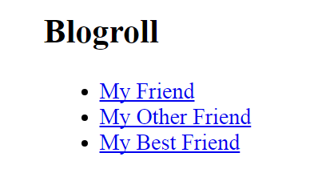
Semantic Tags: Aside
<aside> – defines a sidebar (left / right navigation)
Main site content
Sidebar:
<aside>
...
<aside>
<h2>Blogroll</h2>
<ul>
<li><a href="#">My Friend</a></li>
<li><a href="#">My Other Friend</a></li>
<li><a href="#">My Best Friend</a></li>
</ul>
</aside>

Slide 19
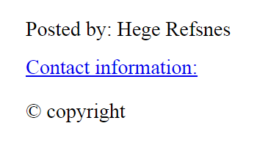
Semantic Tags: Footer
<footer> – a document / section footer
Document author + contact info + copyright info
<footer>
<p>Posted by: Hege Refsnes</p>
<p><a href="someone@exam.uk">Contact...</a></p>
<p>&copy;copyright</p>
</footer>

Slide 20
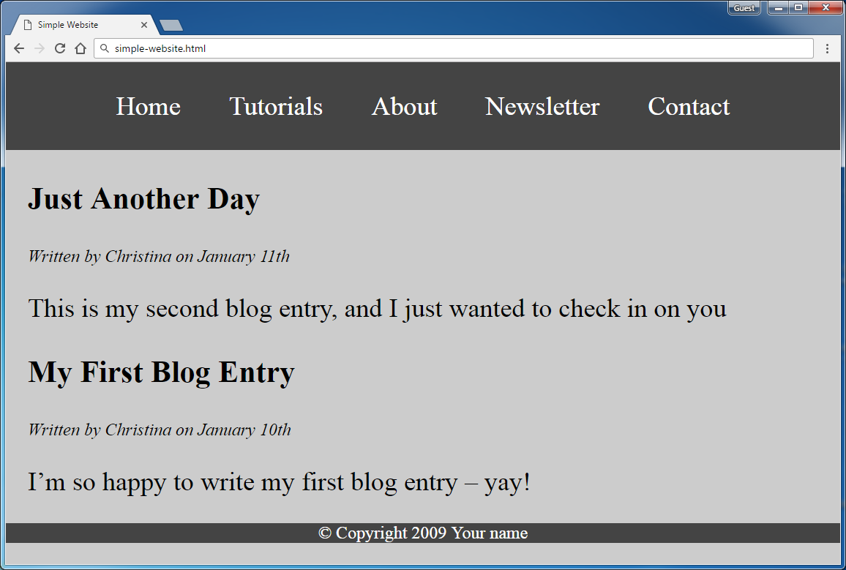
Problem: Simple Website

Slide 21
Solution: Simple Website (HTML + CSS)
<nav>
<ul>
<li><a href="#">Home</a></li>
<!-- TODO: add the missing links -->
</ul>
</nav>
<section>
<article><!-- TODO: use the code from prevous problem --></article>
</section>
<footer>
<p>&copy; Copyright 2009 …</p>
</footer>
/* TODO: use the CSS from the previous problem */
footer {
background: #444;
color: #fff;
text-align: center;
}
Check your solution here: https://judge.softuni.bg/Contests/395

Slide 22
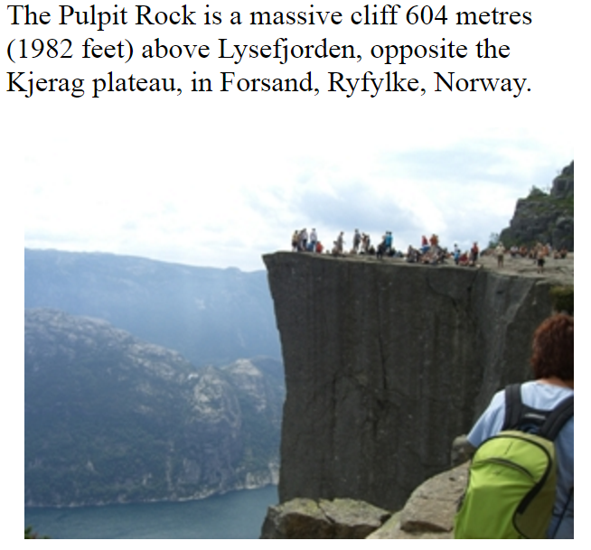
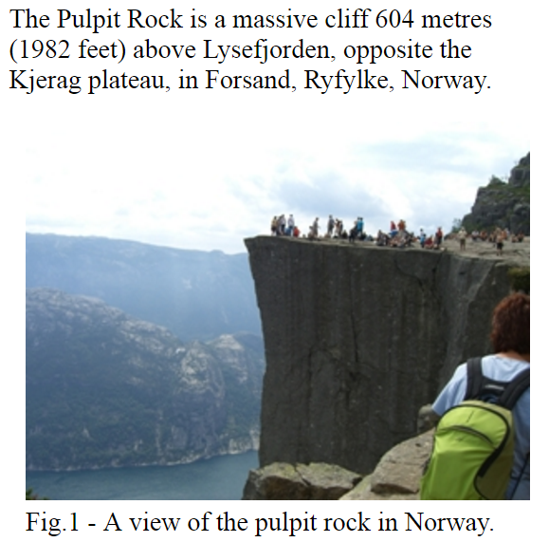
Semantic Tags: Figure + Figcaption
<figure> – element to mark up a photo in a document:
<figcaption> – a caption for a figure element
<p>The Pulpit Rock …</p>
<figure>
<img src="img_pulpit.jpg" alt="The …">
</figure>
Without <figcaption>
<p>The Pulpit Rock …</p>
<figure>
<img src="img_pulpit.jpg" alt="The …">
<figcaption>Fig.1 - A view …</figcaption>
</figure>
With <figcaption>

Slide 23

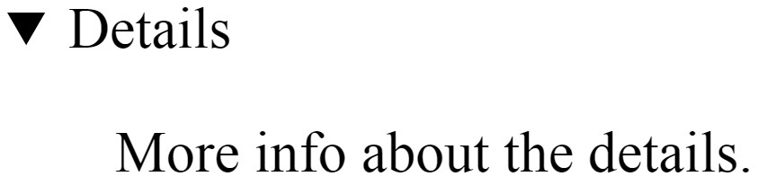
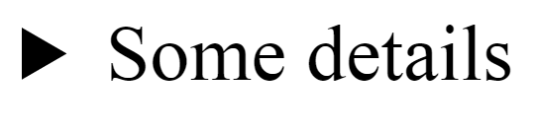
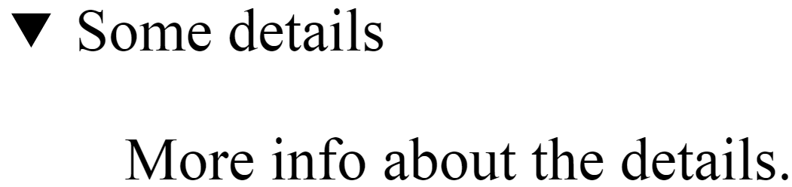
Semantic Tags: Details + Summary
<details> – tag specifies additional details
<summary> – a visible heading for the <details>
<details>
<p>More info about the details.</p>
</details>
expand
<details>
<summary>Some details</summary>
<p>More info about the details.</p>
</details>
expand

Slide 24
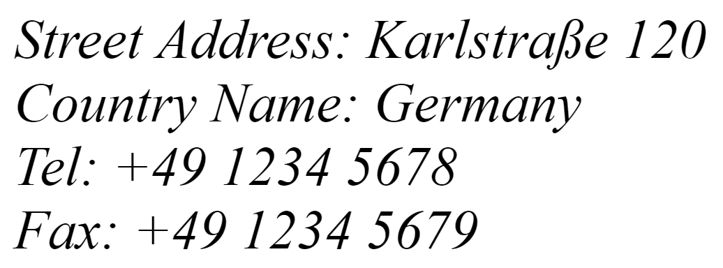
Semantic Tags: Time + Address
<time> – a human-readable time
<address> – contact information for site author / owner
<p>
We open at <time>10:00</time> every morning.
</p>
<address>
Street Address: Karlstraße 120<br/>
Country Name: Germany<br/>
Tel: +49 1234 5678<br/>
Fax: +49 1234 5679
</address>

Slide 25



Multimedia Context
Embedding Audio and Video

Slide 26
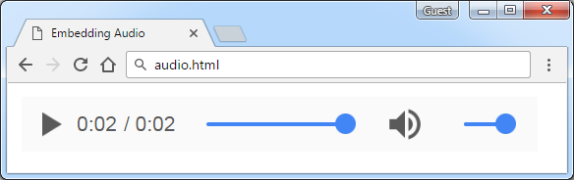
Embedding Audio
The <audio> element inserts audio player in the Web page
Audio formats supported:
MP3, OGG, WAV
Attributes: controls, autoplay, loop, preload
<audio controls autoplay>
<source src="horse.mp3" type="audio/mpeg">
</audio>

Slide 27
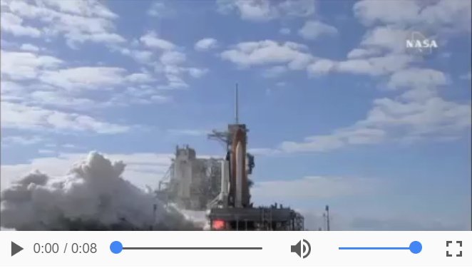
Embedding Video
The <video> element inserts video player in your site
Video formats: MP4, OGG, WebM
Attributes: width, height, poster, controls, autoplay, loop
<video controls="controls">
<source src="shuttle.mp4" type="video/mp4">
<source src="shuttle.ogv" type="video/ogg">
Your browser does not support the HTML5 video.
</video>

Slide 28
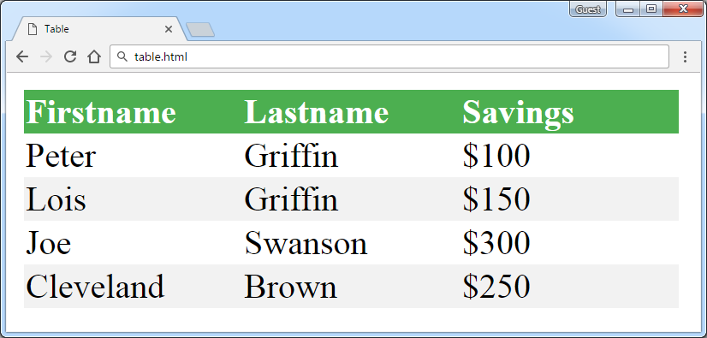
HTML Tables
Tags For Building Tables

Slide 29
Simple HTML Tables
Simple HTML tags for creating tables: <table>, <tr>, <td>
<table>
<tr>
<td>Cell 1.1</td>
<td>Cell 1.2</td>
</tr>
<tr>
<td>Cell 2.1</td>
<td>Cell 2.2</td>
</tr>
</table>
HTML table defined by the <table> tag
Rows defined by the <tr> tag
Table data (cells) defined by the <td> tag

Slide 30
Complete HTML Tables
Complete tables use best practices in HTML 5
There are three specific parts in every table:
Table header
Table body
Table footer
Each table part holds rows (<tr>)
Rows hold cells (<td> / <th>)
<table>
<thead>…</thead>
<tbody>
<tr>
<td>Mark</td>
<td>5,75</td>
</tr>
</tbody>
<tfoot>…</tfoot>
</table>

Slide 31
Complete HTML Tables
<table>
<thead>
<tr>
<th>Name</th>
<th>Mark</th>
</tr>
</thead>
<!-- TODO: <tbody> -->
<tfoot>
<tr>
<td>Average</td>
<td>4.12</td>
</tr>
</tfoot>
</table>
Table header
<thead> group header content in an HTML table
Holds <tr> with <th> header cells
Table body: <tr> with <td> cells
Table footer
<tfoot> group footer content in an HTML table
Holds <tr> with <td> cells

Slide 32
Complete HTML Tables
Merge rows and columns
Columns
<td colspan="2">Sum: $180</td>
Rows
colspan="1"
colspan="1"
rowspan="2"
rowspan="1"
Cell [1,1]
Cell [1,2]
Cell [1,1]
Cell [1,2]
Cell [2,2]
Cell [2,1]
colspan="2"
rowspan="1"

Slide 33
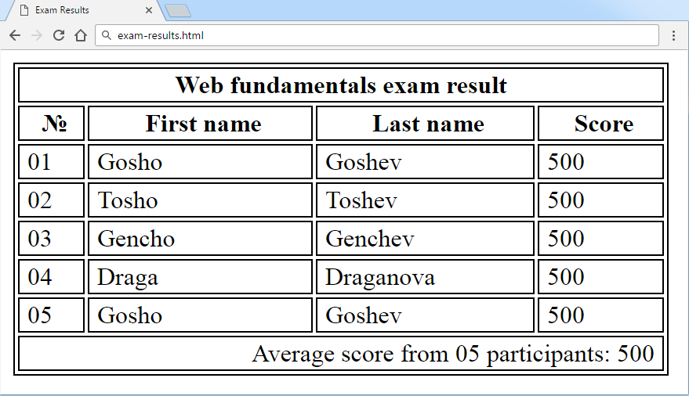
Problem: Exam Results
<thead>
<tr>
<th>…</th>
</tr>
</thead>
Create a HTML table like the screenshot below:
<tbody>
<tr>…</tr>
</tbody>
<tfoot>
<tr>…</tr>
</tfoot>

Slide 34
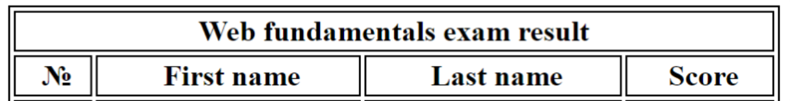
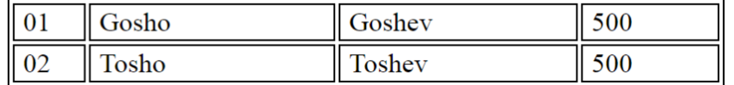
Solution: Exam Results (HTML + CSS)
<table>
<thead>
<tr><th colspan="4">Web Fundamentals</th></tr>
</thead>
<tbody>
<tr>
<td class="bold">&#8470;</td>
<!-- TODO: put the rest <td> here … -->
</tr>
<!-- TODO:put the rest <tr> with <td> here … -->
</tbody>

Slide 35
Solution: Exam Results (More HTML + CSS)
<tfoot>
<tr><td colspan="4" class="result"><!--TODO:--></td></tr>
</tfoot>
</table>
table, td, tr, th {
border: 1px solid #000000;
}
td {
padding-left: 5px;
}
.bold {
font-weight: bold;
text-align: center;
}
.result {
width: 400px;
text-align: right;
padding-right: 5px; }
Check your solution here: https://judge.softuni.bg/Contests/395

Slide 36
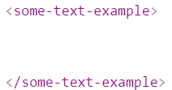
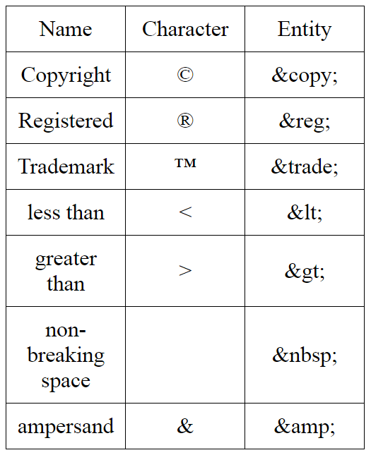

HTML Entities
Character entities show special characters in HTML
Incorrect html-tag
<some-Text-example>
Will display <some-Text-example>
&lt;some-Text-example&gt;

Slide 37

Browser Support
Modernizr
Modern HTML for old browsers
http://modernizr.com
EXAMPLE
EXAMPLE
EXAMPLE
EXAMPLE
EXAMPLE

Slide 38

Summary
HTML document structure:
HTML semantic tags:
HTML table tags:
HTML entities:
<!DOCTYPE>,<html>,<head>,<body>
<nav>,<header>,<main>,<footer>…
<table>,<thead>,<tbody>,<tfoot>…
&copy; &trade; &lt &gt…

